Slide 1
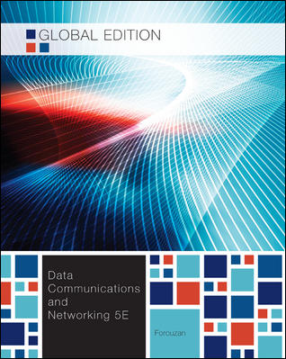
Chapter 6
Bandwidth Utilization
School of Computer Science and Engineering
Pusan National University
Jeong Goo Kim

Slide 2
Ch. 6 Outline
    Outline
6.1 MULTIPLEXING
6.2 SPREAD SPECTRUM

Slide 3
    Ch. 6 Objective
    Objective
Multiplexing
  FDM
  WDM
  TDM
spectrum spreading
  FHSS
  DSSS

Slide 4

    6.1 Multiplexing
    6.1 Multiplexing
is the set of techniques that allows the simultaneous transmission of multiple signals across a single data link.
Fig. 6.1 Dividing a link into channels

Slide 5
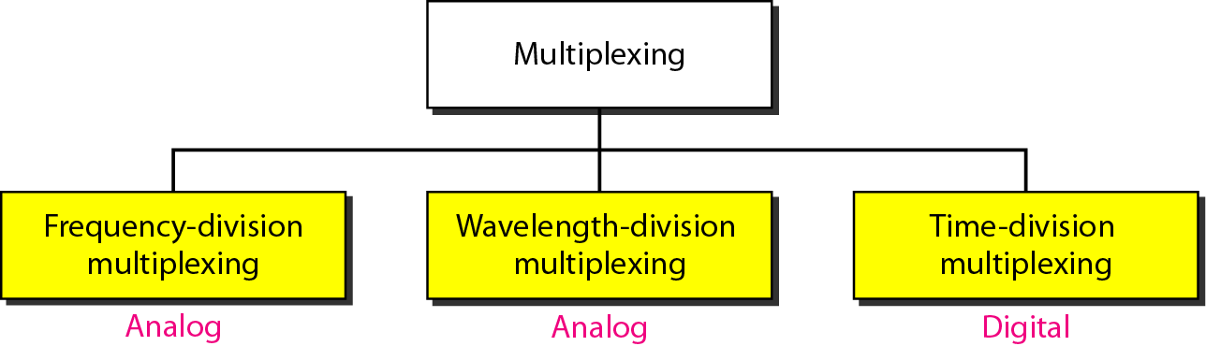
    6.1 Multiplexing
Fig. 6.2 Categories of multiplexing

Slide 6
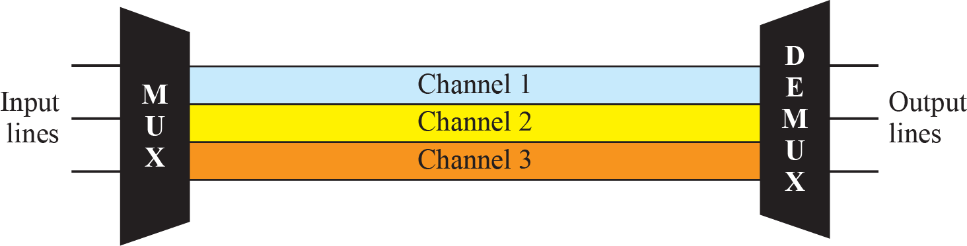
    6.1 Multiplexing
    6.1.1 FDM
is an analog technique that can be applied when the bandwidth of a link (in hertz) is greater than the combined bandwidths of the signals to be transmitted.
Fig. 6.3 FDM

Slide 7
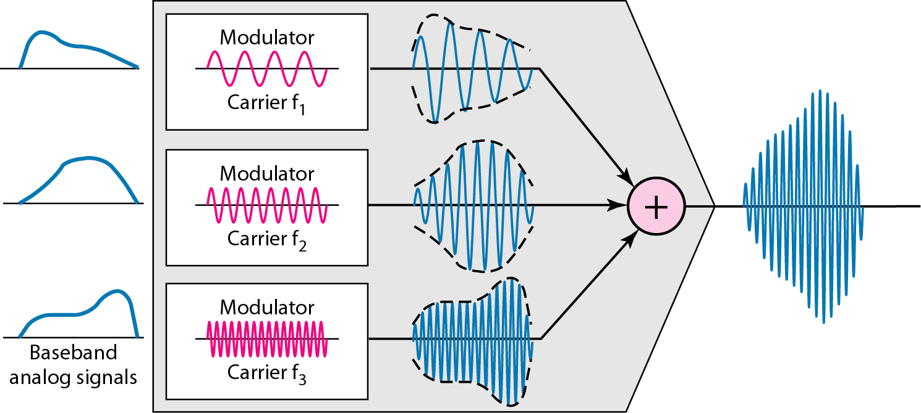
    6.1 Multiplexing
Fig. 6.4 FDM Process

Slide 8
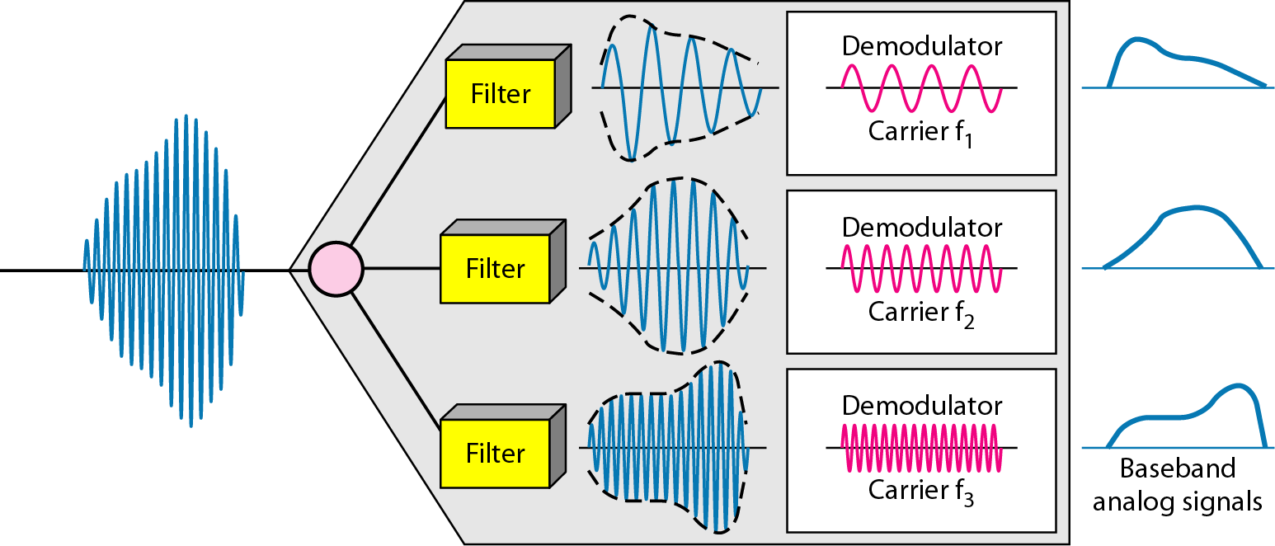
    6.1 Multiplexing
Fig. 6.5 FDM demultiplexing

Slide 9
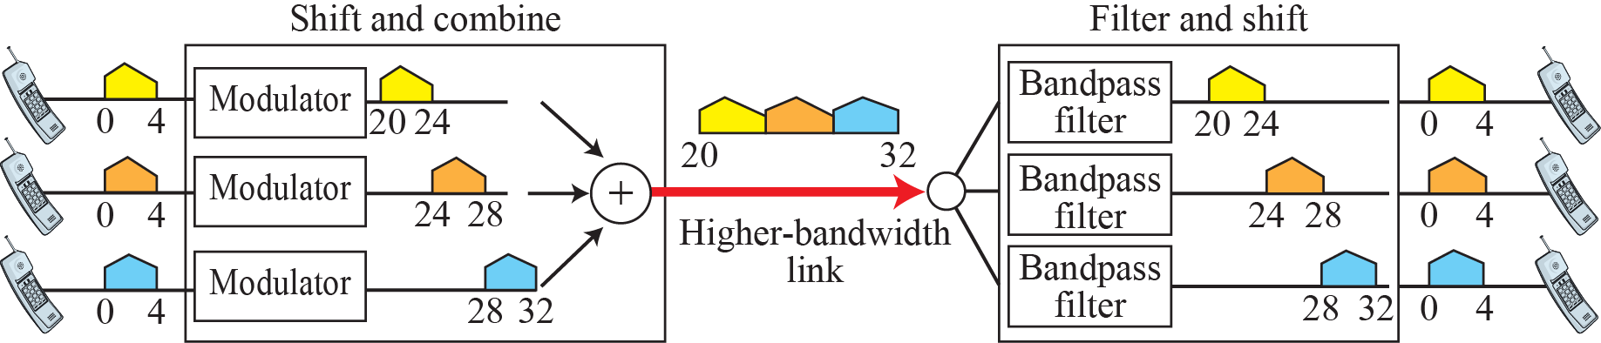
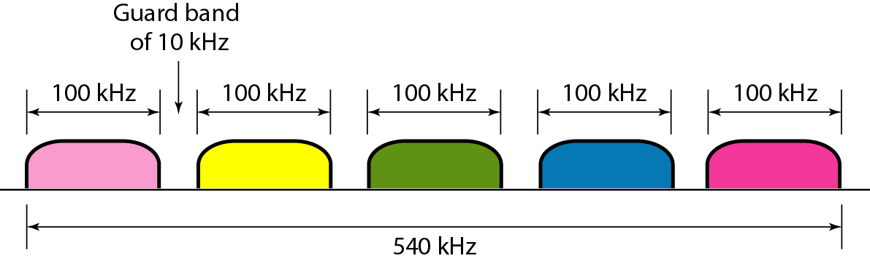
    6.1 Multiplexing
Fig. 6.6 Example 6.1
Fig. 6.7 Example 6.2

Slide 10
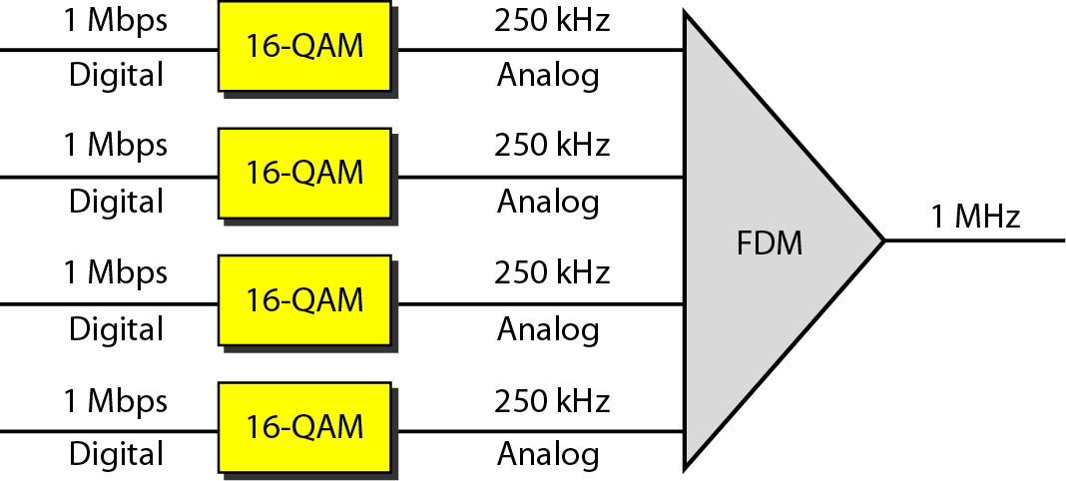
    6.1 Multiplexing
Fig. 6.8 Example 6.3

Slide 11
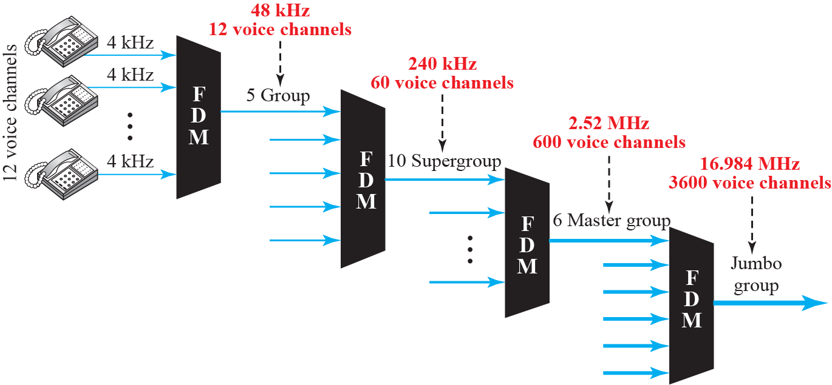
    6.1 Multiplexing
Fig. 6.9 Analog hierarch

Slide 12
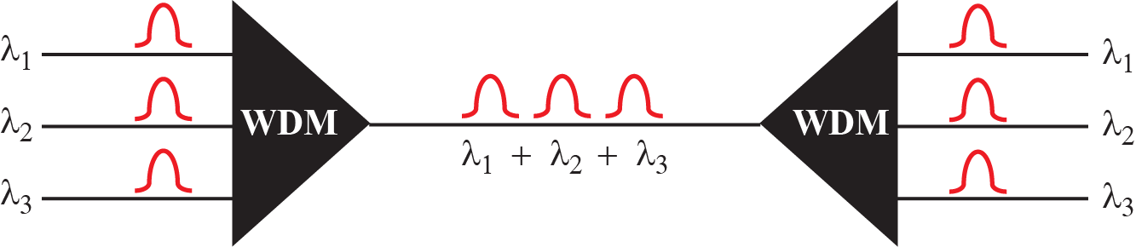
    6.1 Multiplexing
    6.1.2 WDM
is designed to use the high-data-rate capability of fiber-optic cable.
Fig. 6.10 WDM

Slide 13
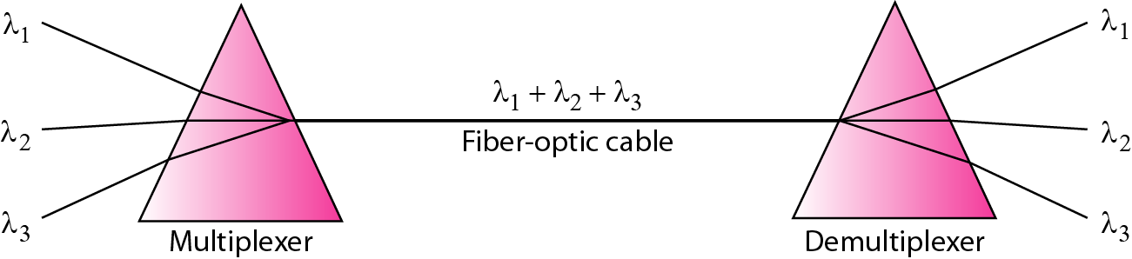
    6.1 Multiplexing
Fig. 6.11 Prisms in wave-length division multiplexing

Slide 14
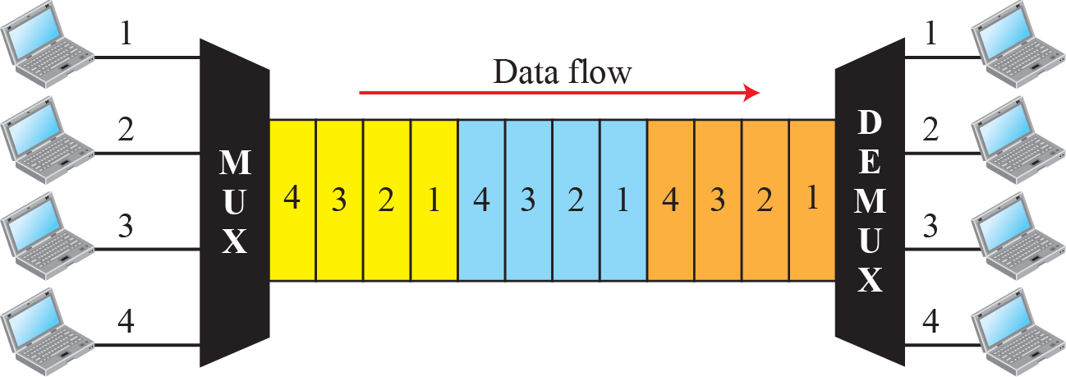
    6.1 Multiplexing
    6.1.3 TDM
is a digital process that allows several connections to share the high bandwidth of a link.
instead of sharing a portion of the bandwidth as in FDM, time is shared.
Fig. 6.12 TDM

Slide 15
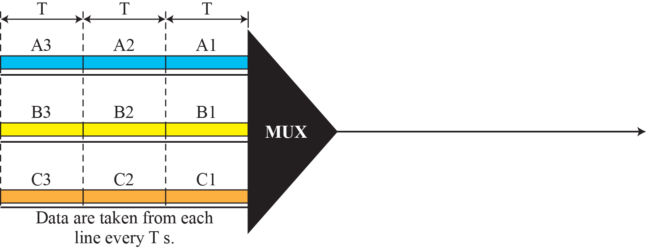
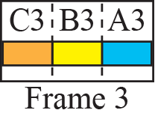
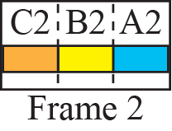
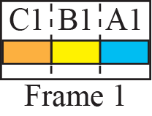
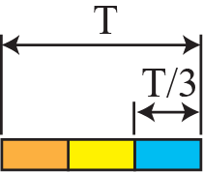

    6.1 Multiplexing
Fig. 6.13 Synchronous time-division multiplexing

Slide 16
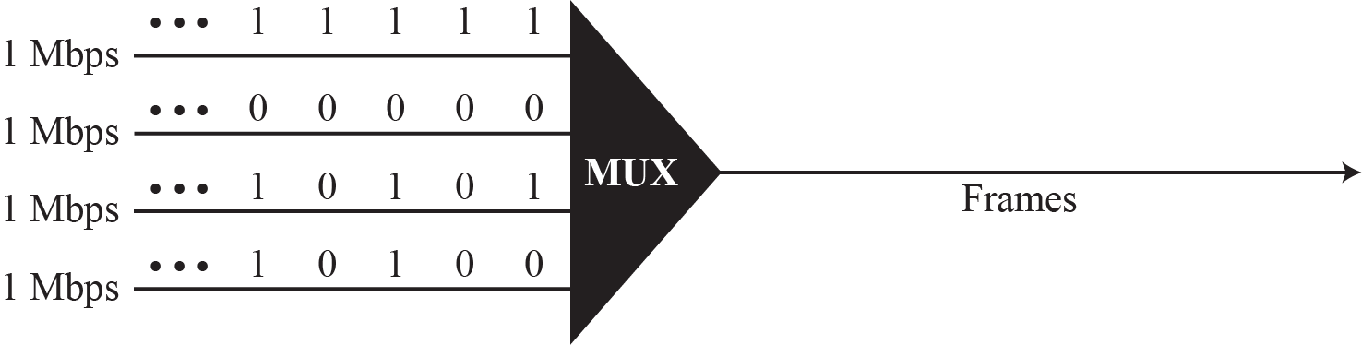
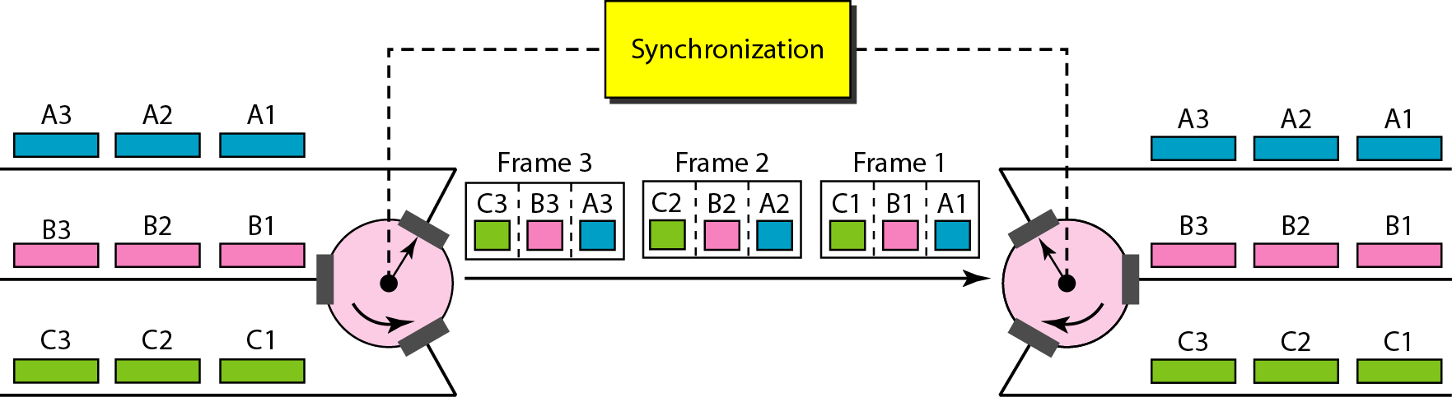
    6.1 Multiplexing
Fig. 6.14 Example 6.6
Fig. 6.15 Interleaving

Slide 17
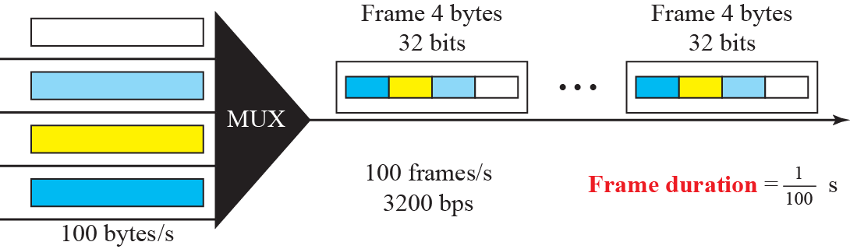
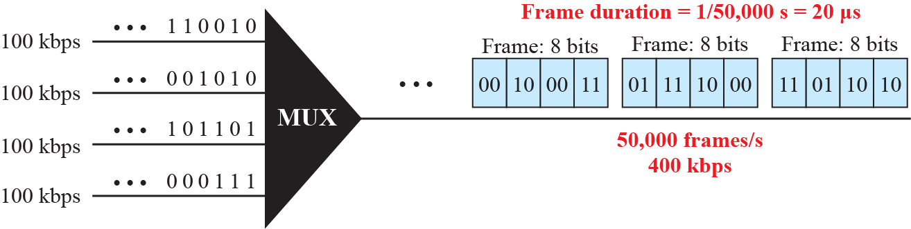
    6.1 Multiplexing
Fig. 6.16 Example 6.8
Fig. 6.17 Example 6.9

Slide 18
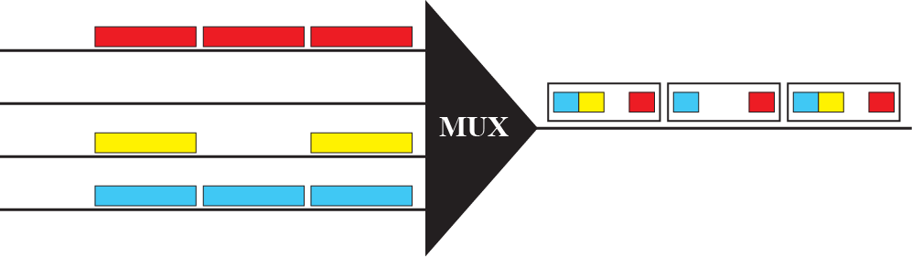
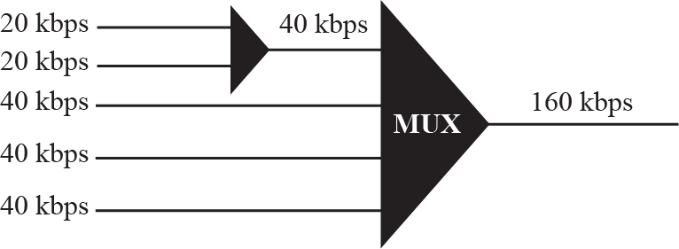
    6.1 Multiplexing
Fig. 6.18 Empty slots
Fig. 6.19 Multilevel multiplexing

Slide 19
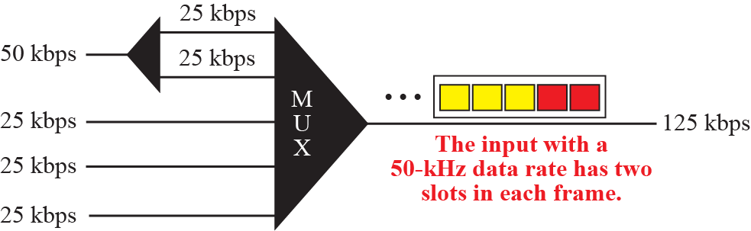
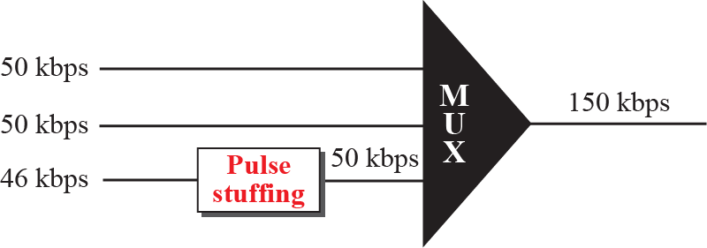
    6.1 Multiplexing
Fig. 6.20 Multiple-slot multiplexing
Fig. 6.21 Pulse stuffing

Slide 20
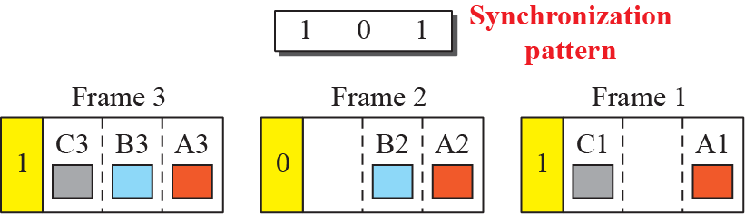
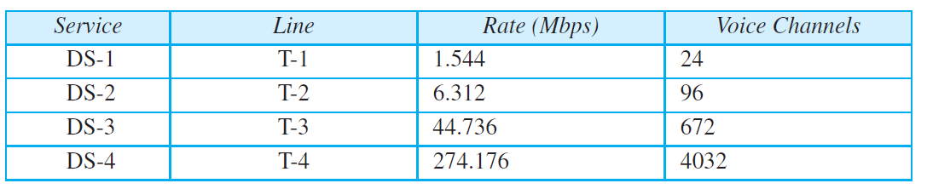
    6.1 Multiplexing
Fig. 6.22 Framing bits
Table 6.1 DS and T line rates

Slide 21
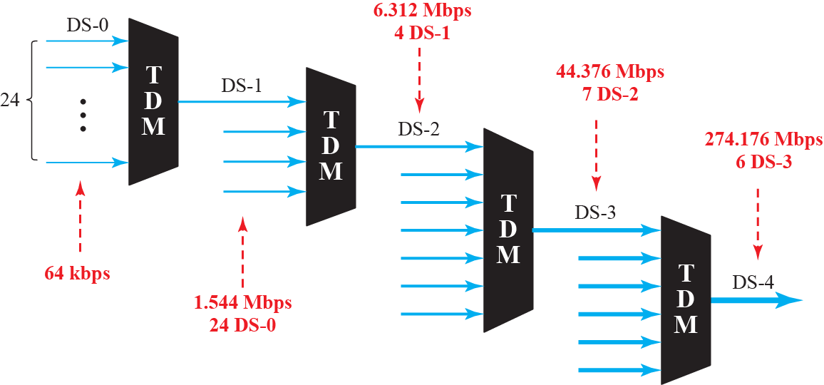
    6.1 Multiplexing
Fig. 6.23 Digital hierarchy

Slide 22
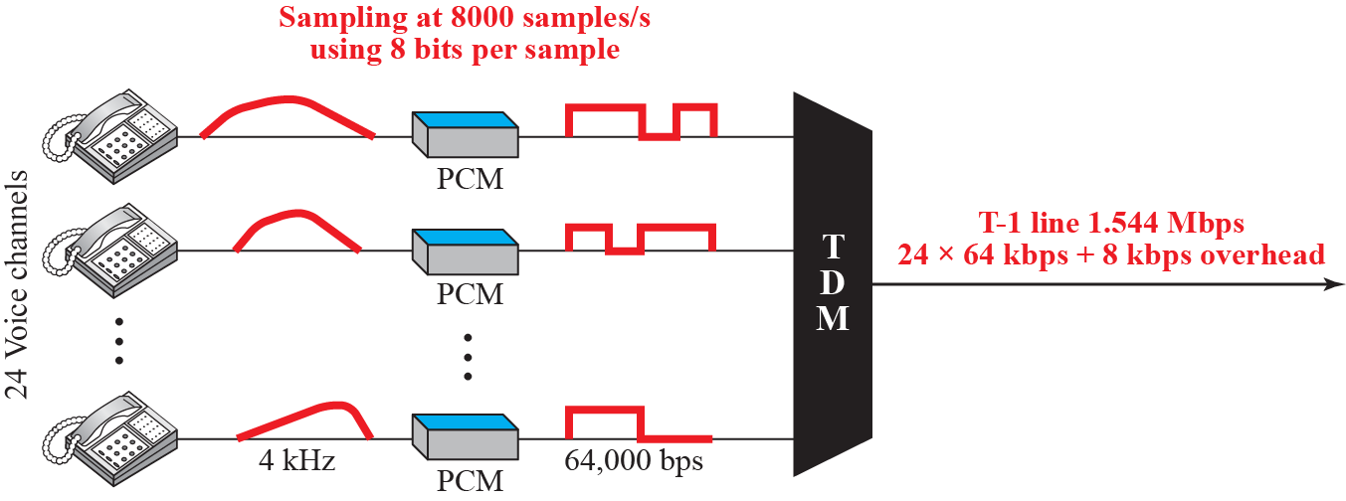
    6.1 Multiplexing
Fig. 6.24 T-1 line

Slide 23
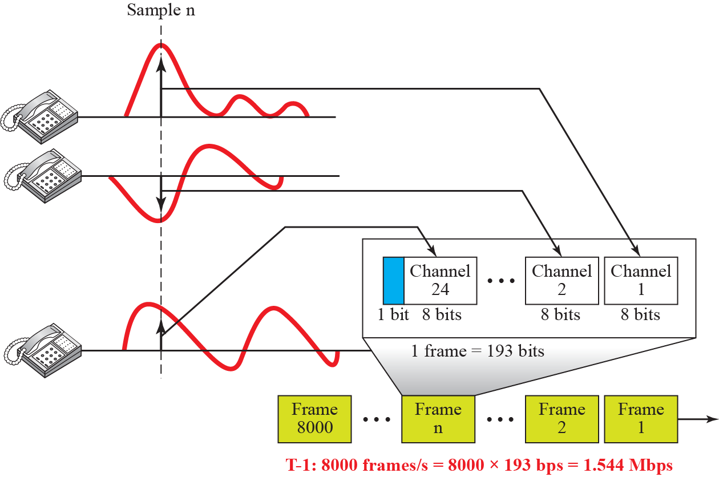
    6.1 Multiplexing
Fig. 6.25 T-1 line frame structure

Slide 24
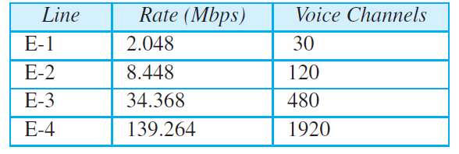
    6.1 Multiplexing
Table 6.2 E line rates

Slide 25
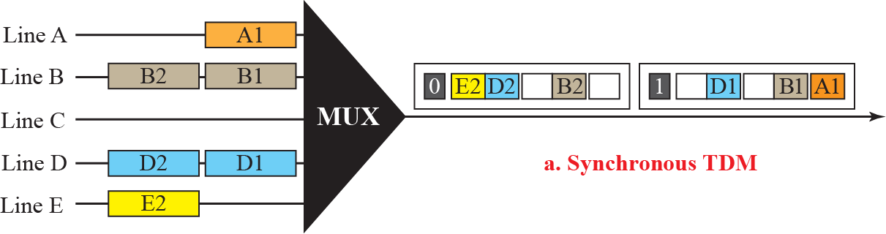
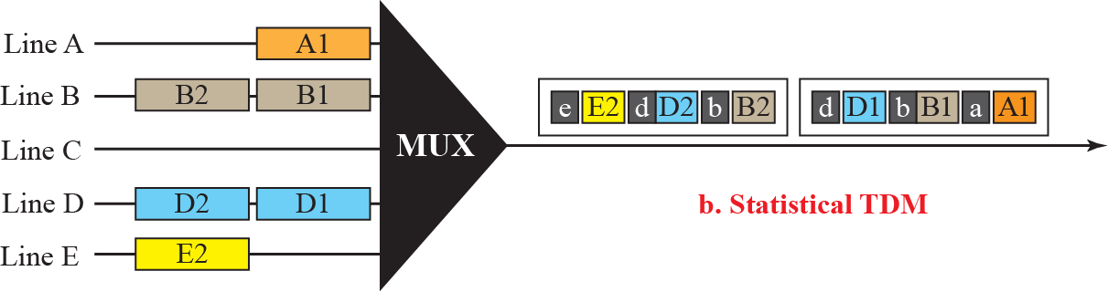
    6.1 Multiplexing
Fig. 6.26 TDM slot comparison

Slide 26
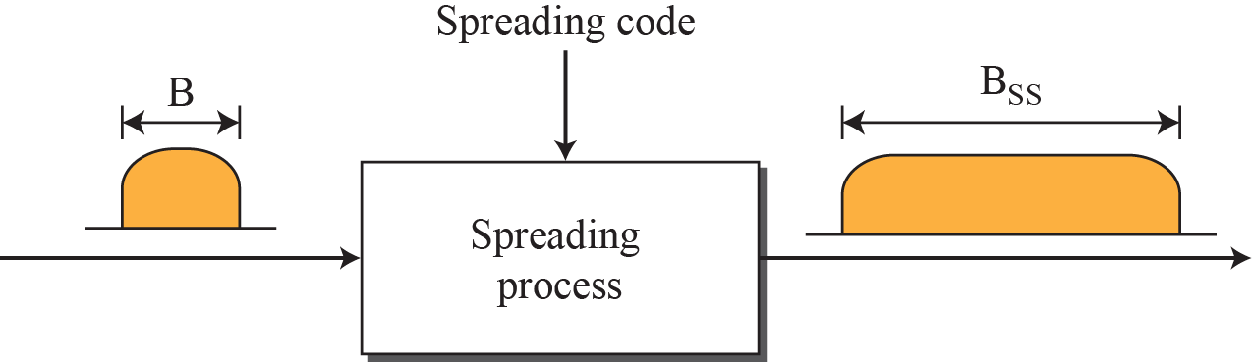
    6.2 Spread Spectrum
    6.2 Spread Spectrum
In wireless applications, stations must be able to share this medium without interception by an eavesdropper and without being subject to jamming from a malicious intruder. To achieve these goals, spread spectrum techniques add redundancy.
Fig. 6.27 Spread spectrum

Slide 27
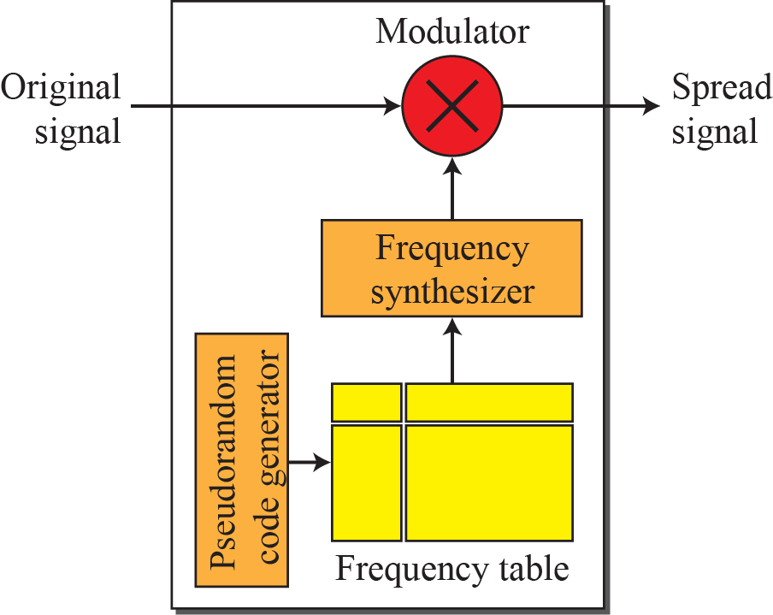
    6.2 Spread Spectrum
    6.2.1 Frequency Hopping Spread Spectrum (FHSS)
uses M different carrier frequencies that are modulated by the source signal.
A pseudorandom code generator, called pseudorandom noise(PN), creates a k-bit pattern for every hopping period T_{h}.
Fig. 6.28 FHSS

Slide 28
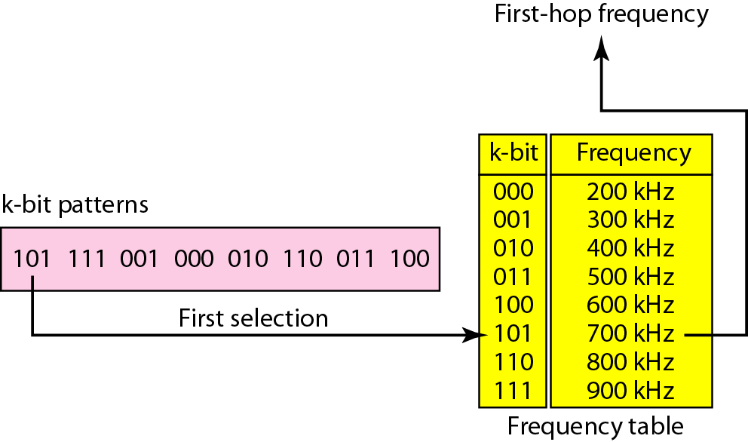
    6.2 Spread Spectrum
Fig. 6.29 Frequency selection in FHSS

Slide 29
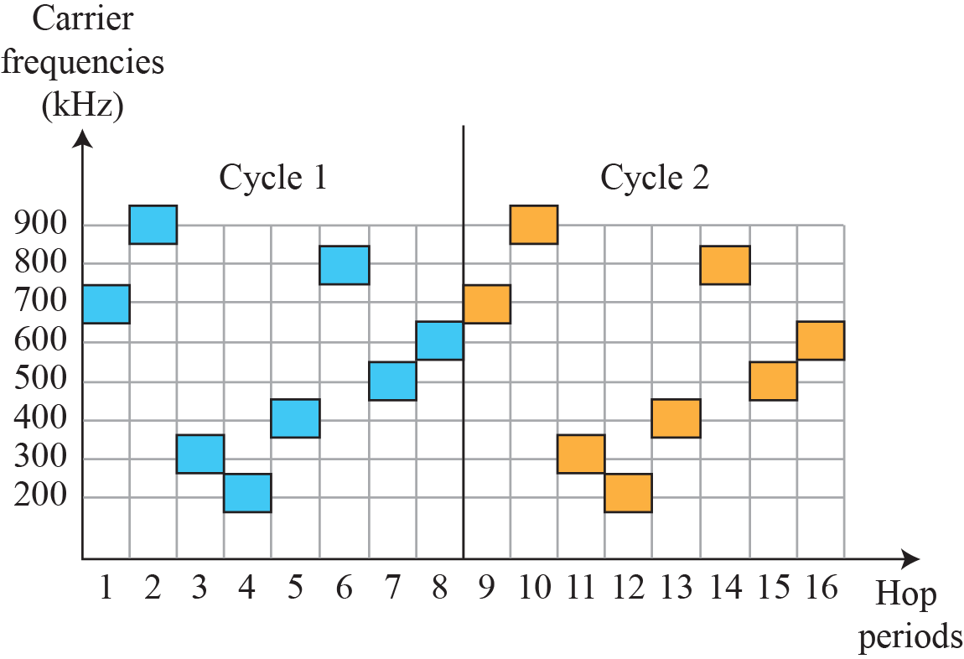
    6.2 Spread Spectrum
Fig. 6.30 FHSS cycles

Slide 30
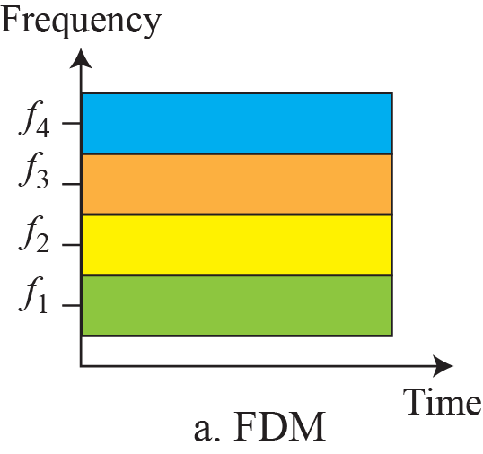
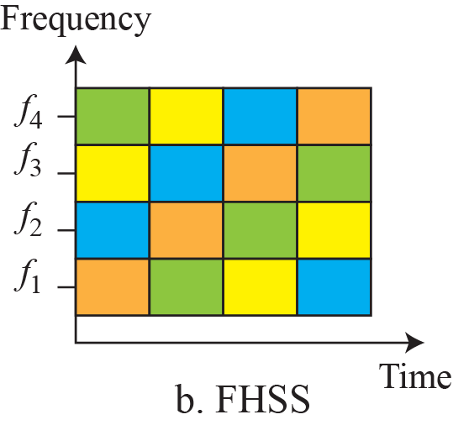
    6.2 Spread Spectrum
Fig. 6.31 Bandwidth sharing

Slide 31
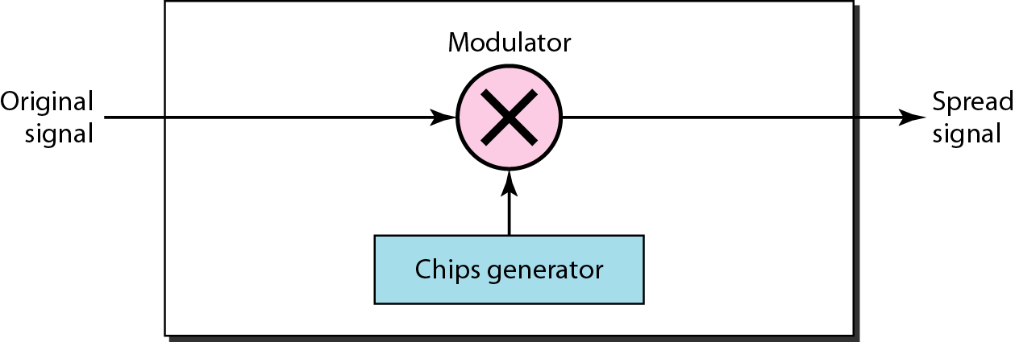
    6.2 Spread Spectrum
    6.2.2 Direct Sequence Spread Spectrum (DSSS)
replace each data bit with n bits using a spreading code.
each bit is assigned a code of n bits, called chips, where the chip rate is n times that of the data bit.
Fig. 6.32 DSSS

Slide 32
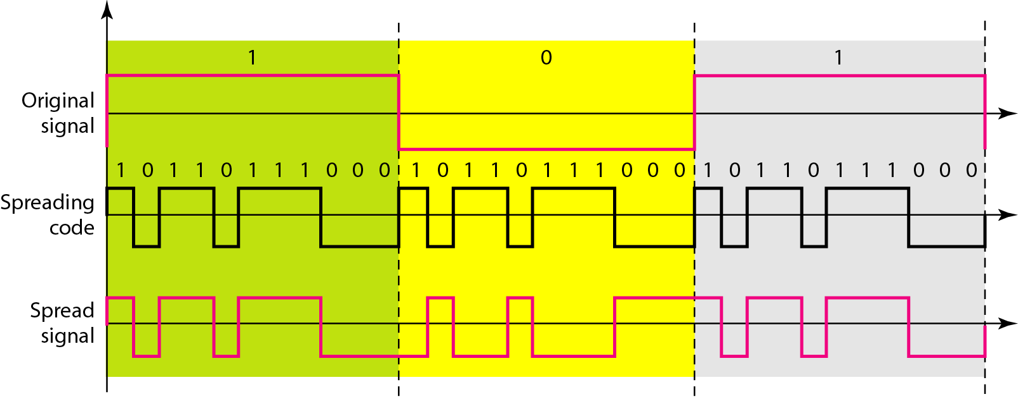
    6.2 Spread Spectrum
Fig. 6.32 DSSS example with Barker sequence n=11.

Slide 33
    Homework
Homework
Read textbook pp. 185-203
Next Lecture
Chapter 7. Transmission Media

